Slide 1
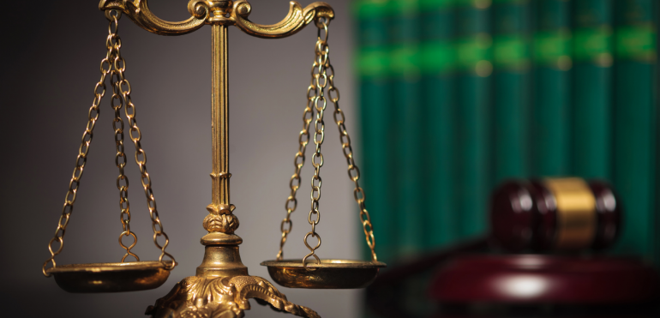
Justice and Fairness Part 2

Slide 2
As mentioned in earlier slides, Issues involving questions of justice and fairness are usually divided into three categories.
1
2
3
Distributive Justice
Retributive justice
Compensatory justice

Slide 3
Retributive Justice
Retributive justice concerns the justice of blaming or punishing persons for doing wrong.
We have discussed some major conditions under which people could not be held morally responsible for what they did: ignorance and inability.
If people do not know or do not freely choose what they are doing, they cannot justly be punished or blamed for it.
A second kind of condition of just punishments is assurance that the person being punished actually did wrong.
Penalizing an employee on the basis of flimsy/inadequate or incomplete evidence is rightly considered an injustice.

Slide 4
Third condition of just punishments is that they must be consistent and proportioned to the wrong.
Punishment is consistent only when everyone is given the same penalty for the same infraction; punishment is proportioned to the wrong when the penalty is no greater in magnitude than the harm that the wrongdoer inflicted.
It is unjust, for example, for a manager to impose harsh penalties for minor infractions of rules or to be lenient toward favorite employees but harsh toward all others.

Slide 5
Compensatory Justice
Compensatory justice concerns the justice of restoring to a person what the person lost when someone wronged him or her.
For example, if I maliciously destroy someone’s property or steal it from him or her, I have an obligation to pay him or her whatever the property I destroyed or stole was worth.
There are no hard and fast rules for determining how much compensation a wrongdoer owes the victim.
Compensatory justice requires that compensation should leave the victim as well off as he or she would have been if the wrongdoer had not injured him or her.

Slide 6
However, some losses are very hard to measure.
If I maliciously injure someone’s reputation, for example, how much compensation equals the loss of reputation?
Some losses, moreover, cannot be restored at all:
How can the loss of life or the loss of sight be compensated?

Slide 7
Not all injuries deserve compensation.
Suppose, for example, that while on a crowded street doing nothing wrong, I am shoved against you and in spite of my best efforts to catch myself, my shove causes you to fall and injure yourself. Although I am the one who directly caused your injury, since I am not morally responsible for what happened, I am not obligated to compensate you.
Under what conditions is a person bound to compensate a party he or she injures? Traditional moralists have argued that a person has a moral obligation to compensate an injured party only if three conditions are present

Slide 8
The action that inflicted the injury was wrong or negligent.
For example, if by efficiently managing my firm I undersell my competitor and run him or her out of business, I am not morally bound to compensate him or her since such competition is neither wrongful nor negligent.
But if I steal from my employer, then I owe him or her compensation, or if I fail to exercise due care in my driving, then I owe compensation to those whom I injured.

Slide 9
For example, if a banker loans a person money and the borrower then uses it to cheat others, the banker is not morally obligated to compensate the victims; but if the banker defrauds a customer, the customer must be compensated.
2. The person’s action was the real cause of the injury.

Slide 10
For example, if I injure someone’s property accidentally and without negligence, I am not morally obligated to compensate the person. (I may, however, be legally bound to do so depending on how the law chooses to distribute the social costs of injury.) But if I deliberately burn down the house of a person I dislike, then I am bound to compensate the person for the losses I inflicted.
3. The person inflicted/caused the injury voluntarily.

